Slide 1



University POLITEHNICA bucharest FACULTy of energy engineering, department of hydraulic, hydraulic machinery and environmental engineering, Bucharest, romania
FUNDAMENTALS OF HYDRAULIC ANALYSIS
Liana Ioana VUTA
Bucharest 15 March 2022

Slide 2
Athens UPB 012 - Water quality monitoring and control in distribution networks
CONTENT
Hydraulics of pressurized pipeline systems
Head losses in pressurized pipe systems
Water distribution networks

Slide 3
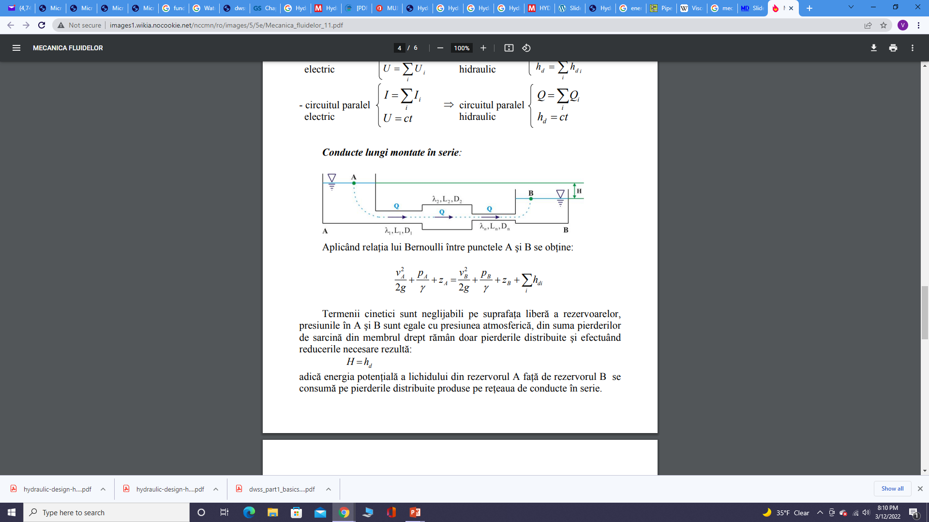
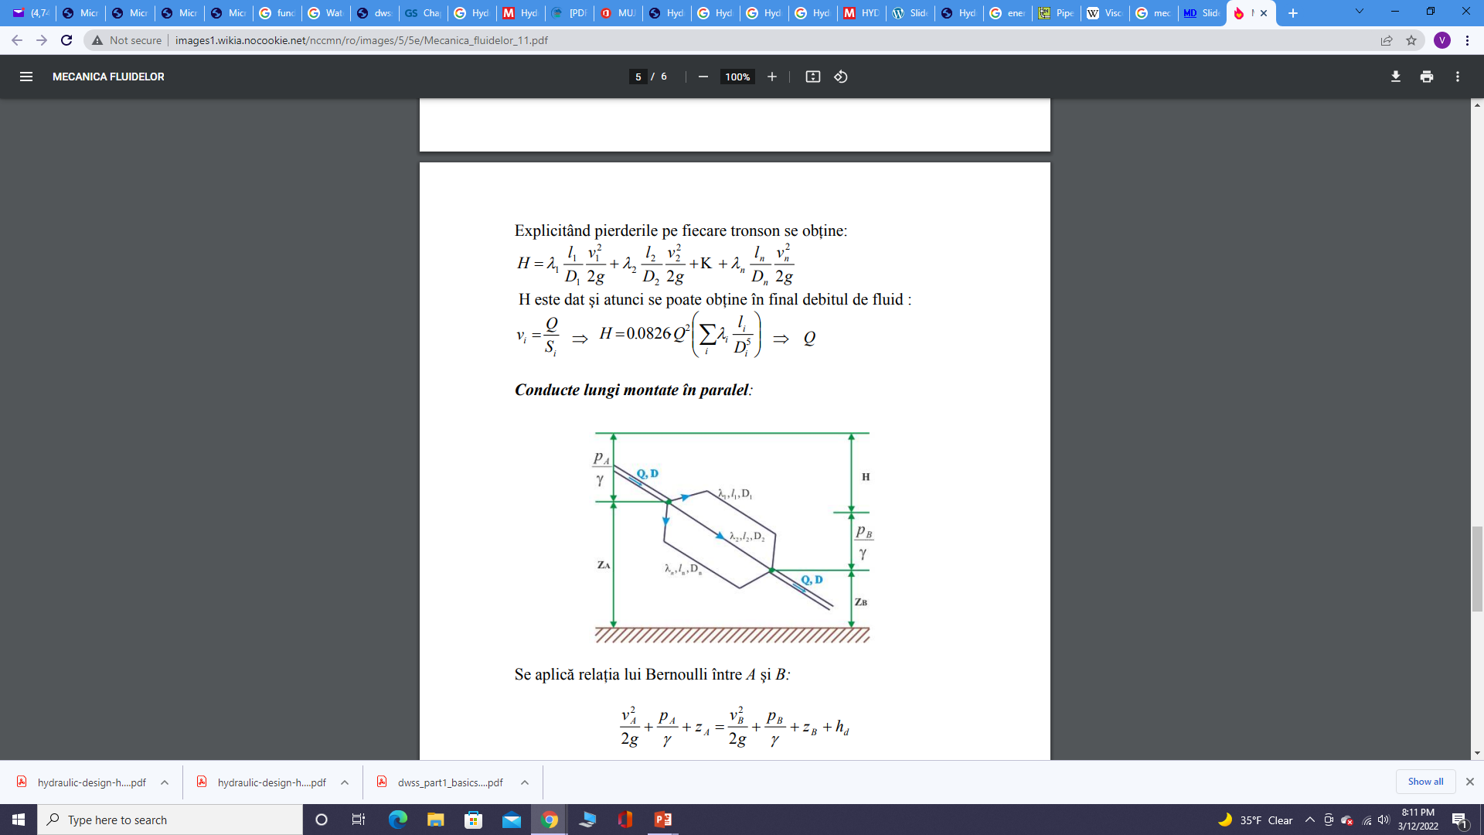
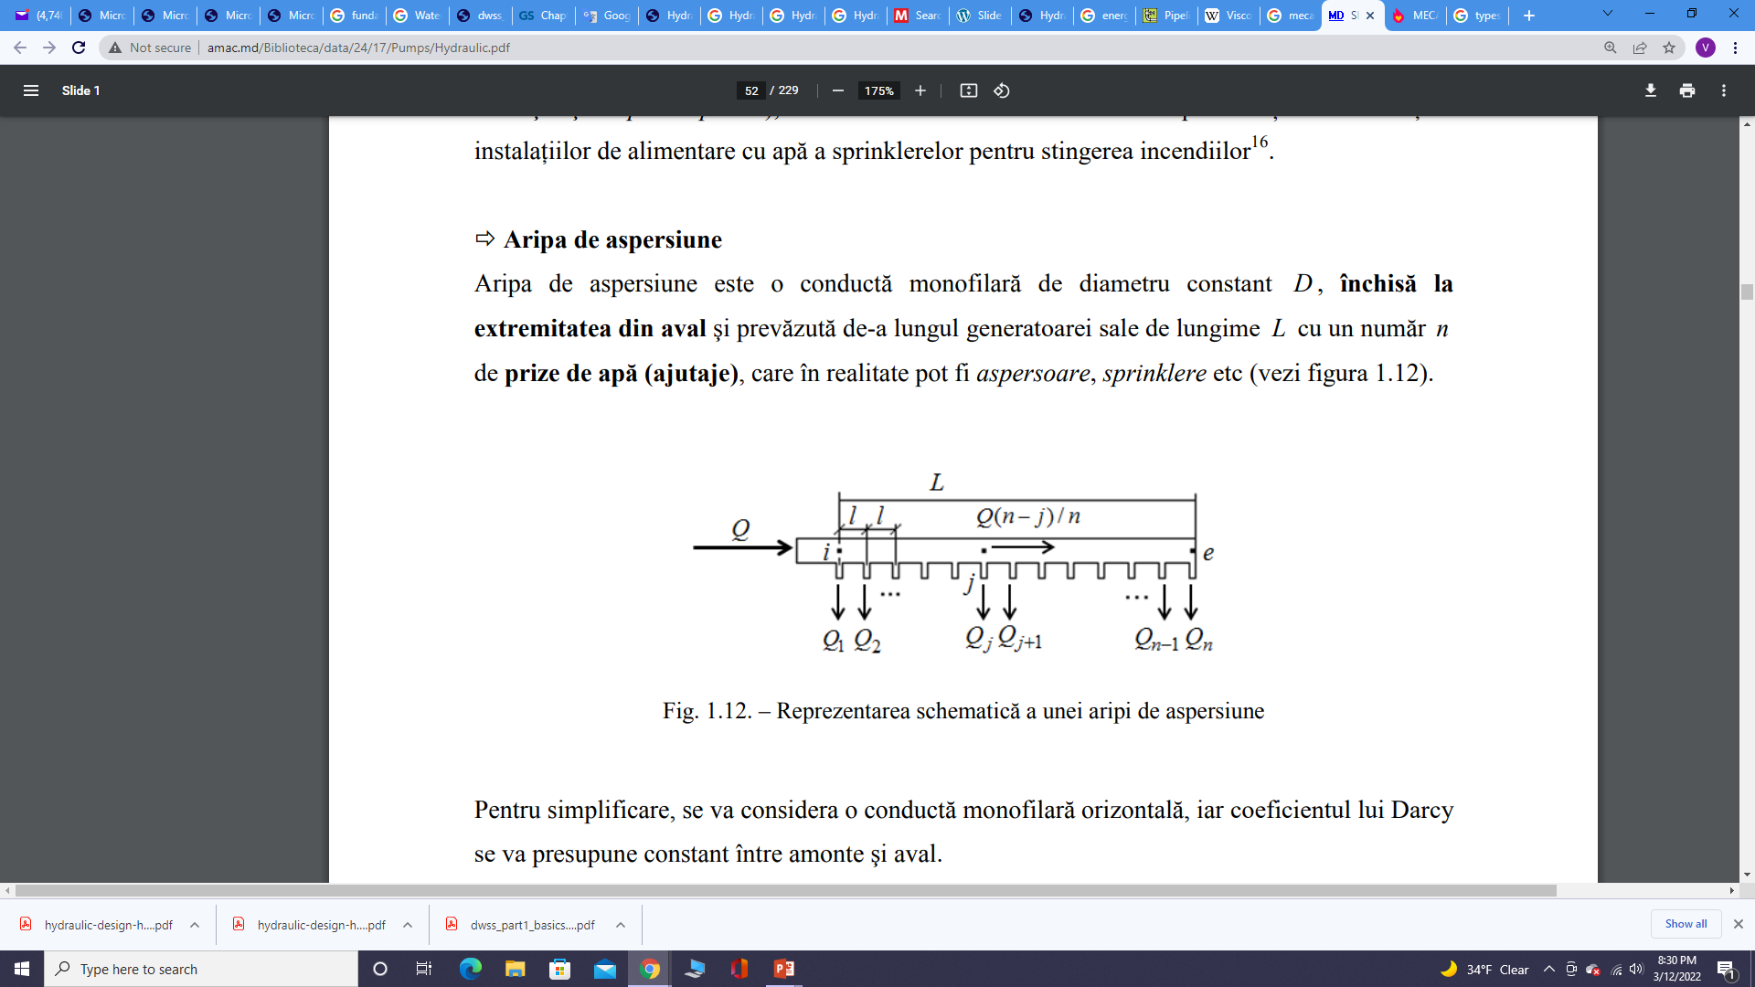
Athens UPB 012 - Water quality monitoring and control in distribution networks
hydraulics of pressurized pipeline systems
Classification
Based on the geometric configuration:
Pipes in series (pipes of different lengths and different diameters connected end to end to form a pipeline);
Pipes in parallel (a main pipe divides into two or more branches and again join together downstream to form a single pipe, then the branched pipes are said to be connected in parallel (compound pipes);
Pipes with distributed released of flow; Sprinkler pipes
Branched networks
Looped networks

Slide 4
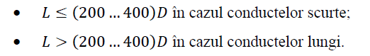
Athens UPB 012 - Water quality monitoring and control in distribution networks
Classification of pressurized pipes
b) Based on the importance of minor head losses:
Short pipes, when minor head losses are comparable with the major head losses;
Long pipes, when minor head losses can be neglected, being smaller than major head losses.
where L represents the length and D the diameter of the pipe

Slide 5
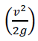
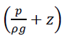
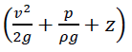
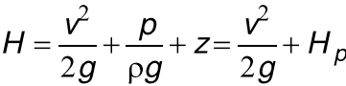
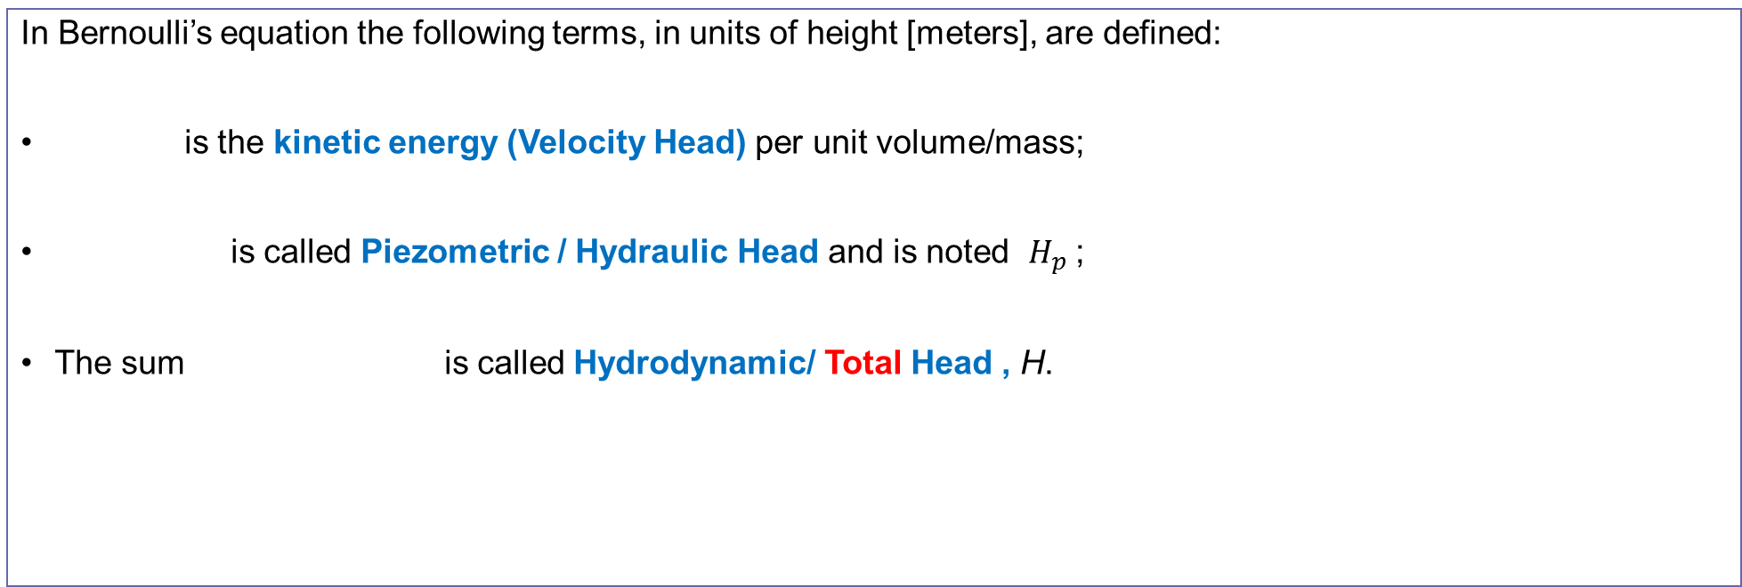
Athens UPB 012 - Water quality monitoring and control in distribution networks
head losses in pressurized pipe systems
The energy law which govern the flow in pressure pipes is called the Bernoulli’s equation.
This equation can be interpreted as an energy balance (energy conservation).
In Bernoulli’s equation the following terms, in units of height [meters], are defined:
is the kinetic energy (Velocity Head) per unit volume/mass;
is called Piezometric / Hydraulic Head and is noted $H_{p}$;
The sum is called Hydrodynamic/ Total Head , H.

Slide 6
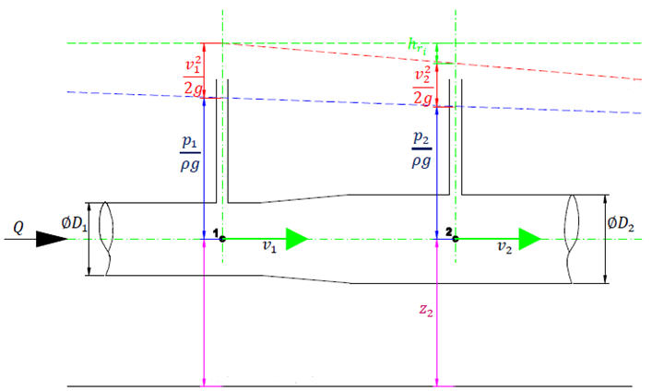
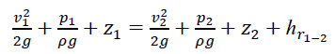
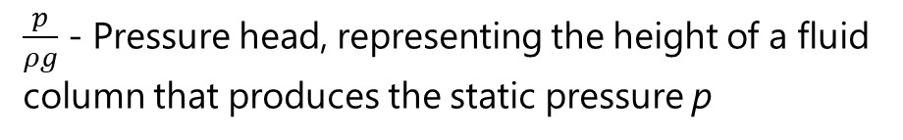
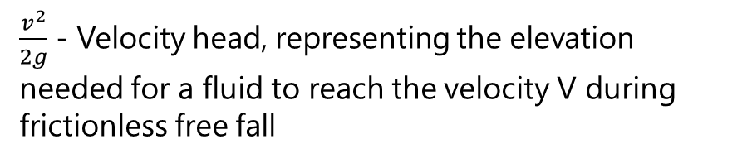
Athens UPB 012 - Water quality monitoring and control in distribution networks
For the pipe in the figure, Bernoulli’s equation between the upstream point, noted 1, and downstream point, noted 2, is:
Theoretic Energy Grade Line
Energy Grade Line
Hydraulic Grade Line
$\frac{v^{2}}{2g}$ - Velocity head, representing the elevation needed for a fluid to reach the velocity V during frictionless free fall
$\frac{p}{ρg}$ - Pressure head, representing the height of a fluid column that produces the static pressure p
Z – Elevation head, representing the potential energy of the fluid
Reference

Slide 7
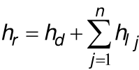
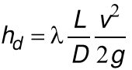
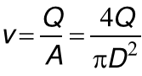
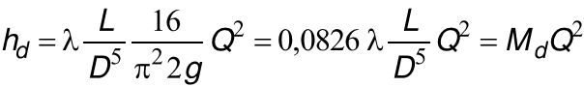
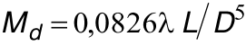
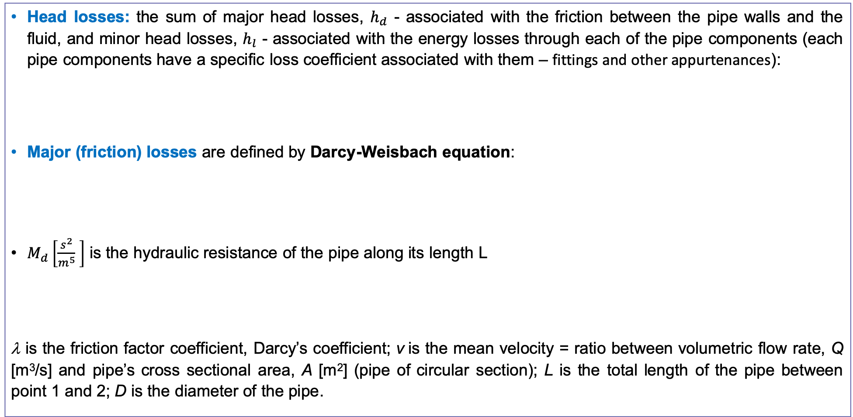
Athens UPB 012 - Water quality monitoring and control in distribution networks
Head losses: the sum of major head losses, $h_{d}$ - associated with the friction between the pipe walls and the fluid, and minor head losses, $h_{l}$ - associated with the energy losses through each of the pipe components (each pipe components have a specific loss coefficient associated with them – fittings and other appurtenances):
Major (friction) losses are defined by Darcy-Weisbach equation:
$M_{d}\left[\frac{s^{2}}{m^{5}} \right]$ is the hydraulic resistance of the pipe along its length L
λ is the friction factor coefficient, Darcy’s coefficient; v is the mean velocity = ratio between volumetric flow rate, Q [m³/s] and pipe’s cross sectional area, A [m²] (pipe of circular section); L is the total length of the pipe between point 1 and 2; D is the diameter of the pipe.

Slide 8
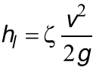
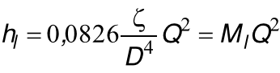
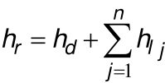
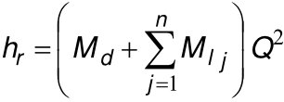
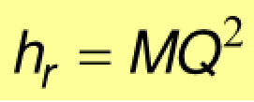
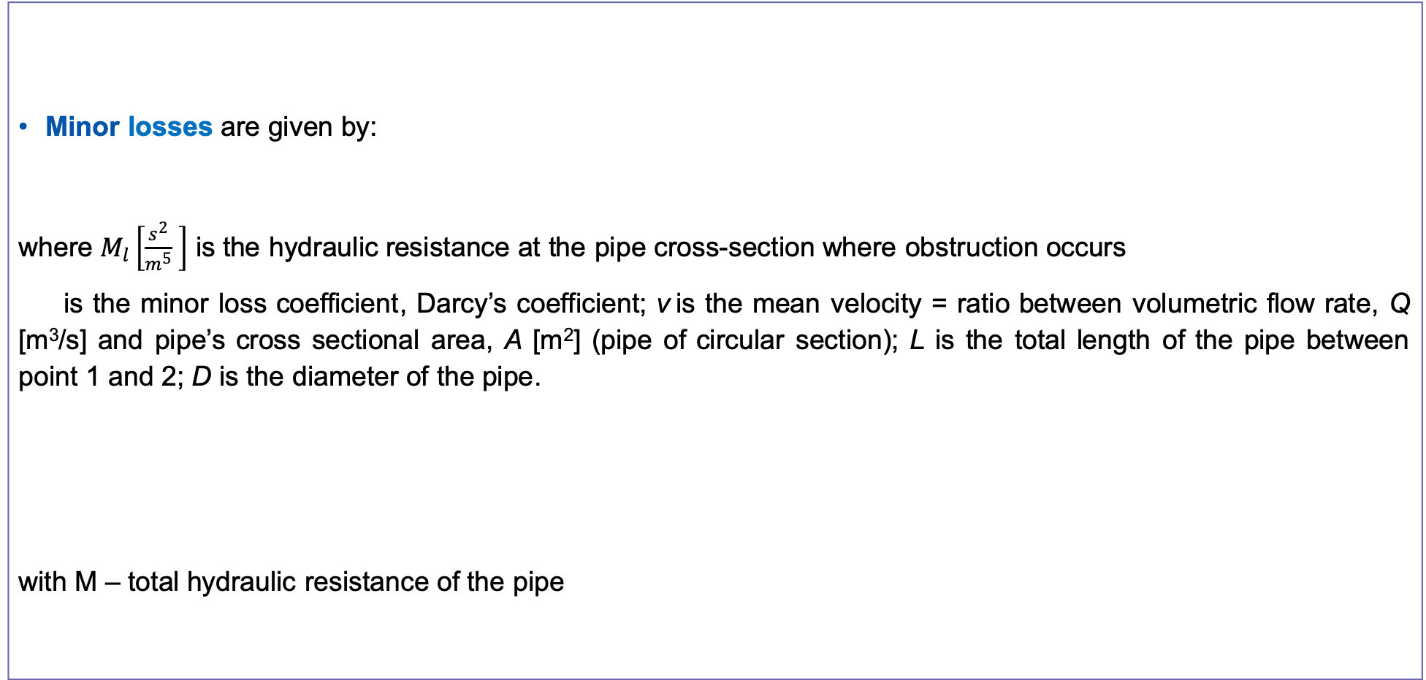
Athens UPB 012 - Water quality monitoring and control in distribution networks
Minor losses are given by:
where $M_{l}\left[\frac{s^{2}}{m^{5}} \right]$ is the hydraulic resistance at the pipe cross-section where obstruction occurs
is the minor loss coefficient, Darcy’s coefficient; v is the mean velocity = ratio between volumetric flow rate, Q [m³/s] and pipe’s cross sectional area, A [m²] (pipe of circular section); L is the total length of the pipe between point 1 and 2; D is the diameter of the pipe.
with M – total hydraulic resistance of the pipe

Slide 9
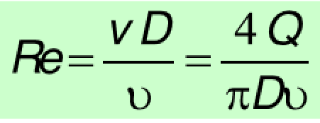
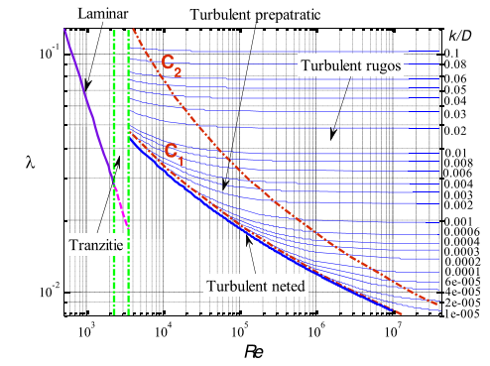
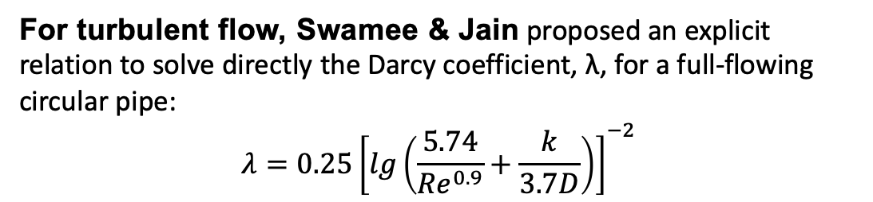
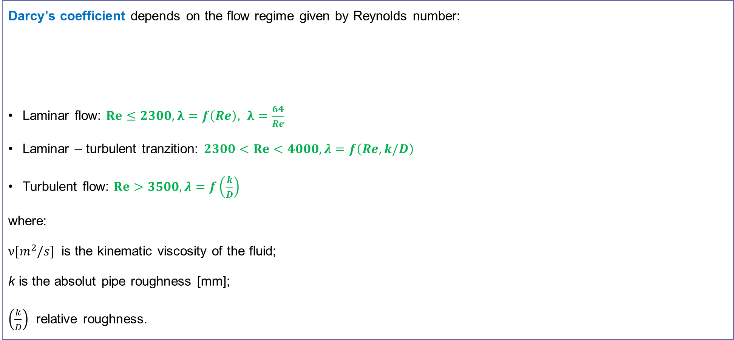
Athens UPB 012 - Water quality monitoring and control in distribution networks
Darcy’s coefficient depends on the flow regime given by Reynolds number:
Laminar flow: $Re≤2300, λ=f\left(Re\right), λ=\frac{64}{Re}$
Laminar – turbulent tranzition: $2300<Re<4000, λ=f\left(Re, k/D\right)$
Turbulent flow: $Re>3500, λ=f\left(\frac{k}{D}\right)$
where:
$\text{ν}[m^{2}/s]$ is the kinematic viscosity of the fluid;
k is the absolut pipe roughness [mm];
$\left(\frac{k}{D}\right)$ relative roughness.
Laminar
Mixt turbulence
Complete turbulence
Tranzition
Smooth
For turbulent flow, Swamee & Jain proposed an explicit relation to solve directly the Darcy coefficient, λ, for a full-flowing circular pipe:
$$λ=0.25{\left[lg\left(\frac{5.74}{{Re}^{0.9}}+\frac{k}{3.7D}\right)\right]}^{−2}$$

Slide 10
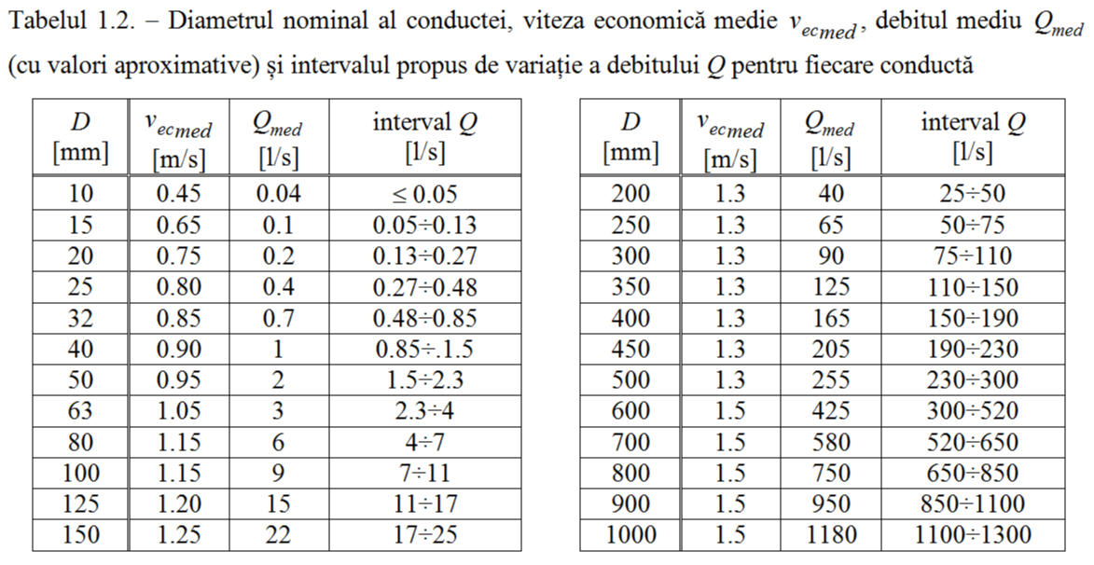
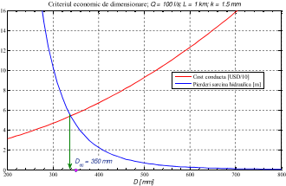
Athens UPB 012 - Water quality monitoring and control in distribution networks
Pipe sizing (economic velocity criteria)
Nominal diameter of the pipe, mean economic velocity, mean volumetric flow-rate (approximate values) and the range of variation of the mean volumetric flow-rate
Economic pipe sizing criteria: Q=100 l/s; L=1km; k=1.5mm
Pipe cost [USD]
Head losses [m]

Slide 11
Athens UPB 012 - Water quality monitoring and control in distribution networks
Water distribution networks

Slide 12
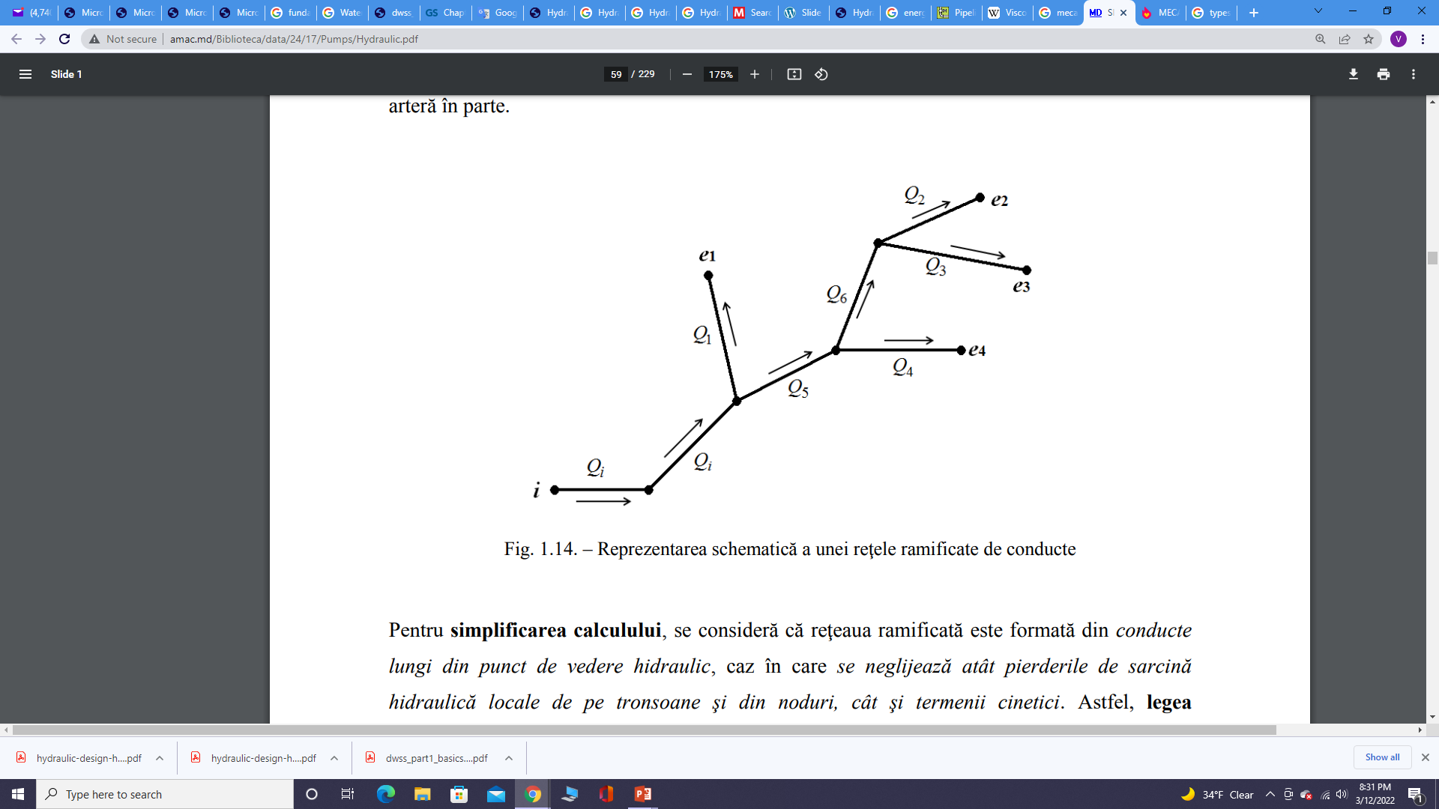
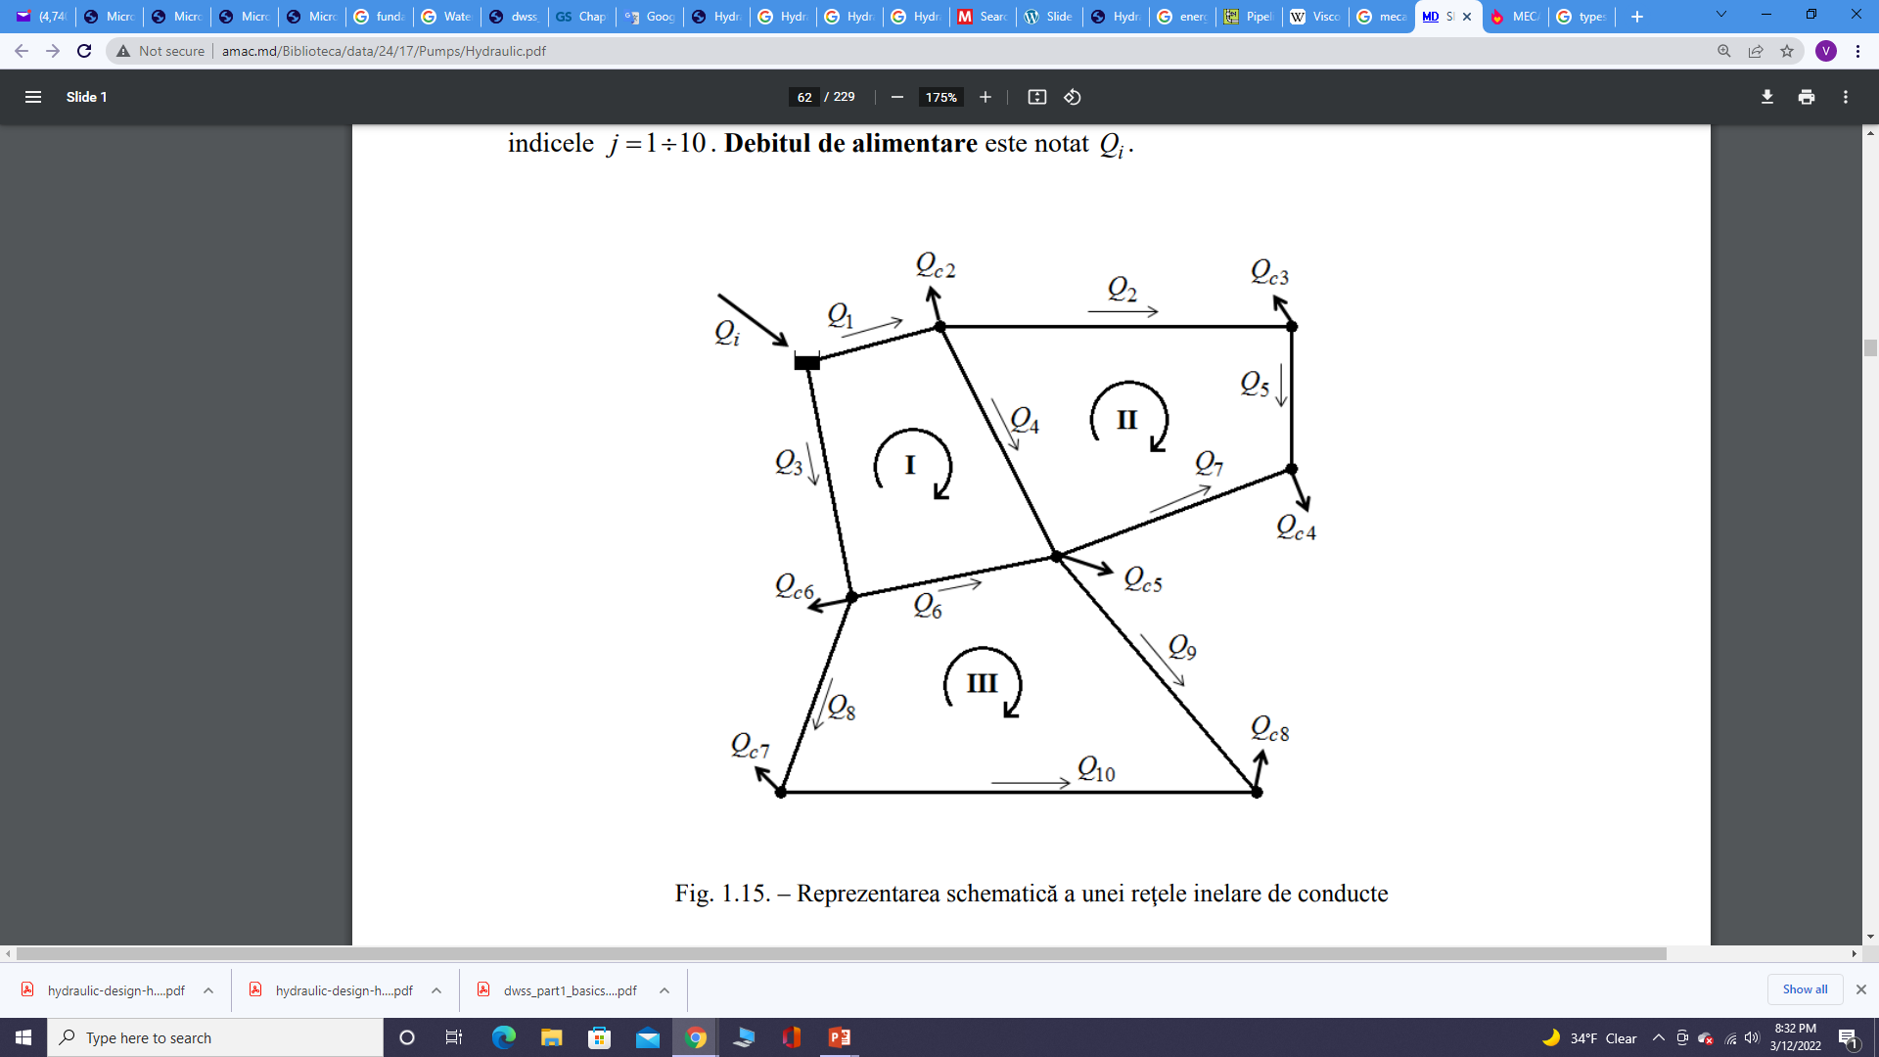
Athens UPB 012 - Water quality monitoring and control in distribution networks
Introduction
Water distribution networks contains pipes and nodes (junctions and reservoirs/tanks). Based on geometric layout of the network we can identify:
Branched or dead-ends or tree network – one main pipeline convey the water to the city and has sub-mains branch lines off from both sides, which are further on branched into several pipelines which provide the water to consumers;
Looped or circular or ring networks – in this case the supply mains forms a ring around the distribution area and the branches are connected cross-wise to the mains and also to each other; two adjacent rings have at least one pipe and two nodes in common. The pipes of the network intersect in nodes, from which consumption flows may or may not be taken;
Mixt networks - In certain nodes of a circular network, branched networks of pipes can be connected, thus resulting in a complex network.

Slide 13
Athens UPB 012 - Water quality monitoring and control in distribution networks
Hydraulic calculation of WDN
The hydraulic calculation of the pipeline networks involves solving a system of equations consisting of:
conservation of energy for pipelines;
the continuity equation in network nodes;
the relations of calculation of the hydraulic head losses, or relations that emphasize the dependence of the pumping height on the conveyed flow, in case of the existence of some machines.
From the hydraulic calculation point of view, there are:
WDN in which the direction of all flow rates on the pipes of the network is known (e.g. branched networks);
WDN in which at least on a pipe the direction of flow rate cannot be established (looped or mixt networks);
Binary networks - a particular case of ring networks that are geometrically calculated with specific relationships to the hydraulic calculation of branched networks;

Slide 14
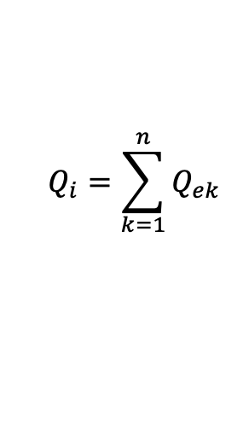
Athens UPB 012 - Water quality monitoring and control in distribution networks
Branched WDN sizing (1)
From a hydraulic point of view, branched/tree WDN are networks in which, generally, the direction and value of the flow rates conveyed by the pipes can be directly determined by using the continuity equations. When the flow rates cannot be obtained directly, the energy laws on the pipes must be written in the form presented for the circular networks, and the resulting system is solved using the algorithm presented for the circular networks.
On the pipes of branched networks fed from a single source, the flow has a unique direction from the supply point i to the consumers node e_{k}, k = 1… n.
For each consumer e_{k} located at the elevation z_{ek}, the required flow Q_{ek} must be ensured, respectively the operating pressure p_{ek} must be ensured. By summing all the Q_{ek} values, the value of the Q_{i} feed rate is obtained.
$$Q_{i}=\sum_{k=1}^{n}{Q_{ek}}$$

Slide 15
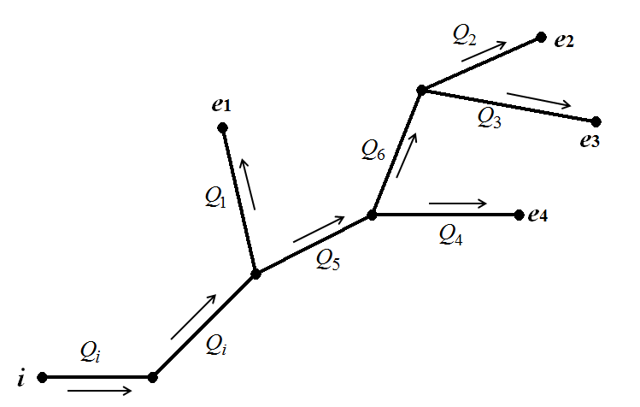
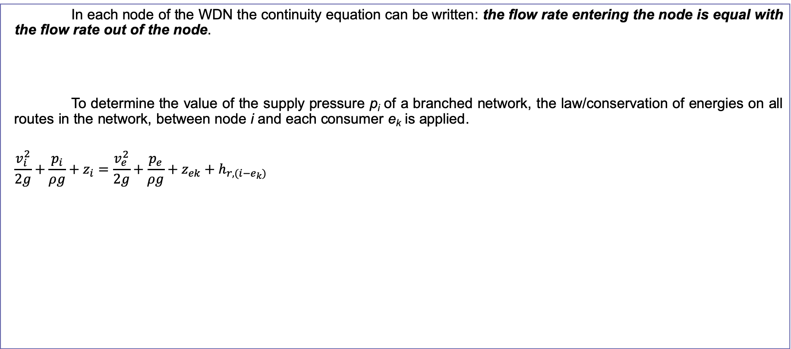
Athens UPB 012 - Water quality monitoring and control in distribution networks
Branched WDN sizing (2)
In each node of the WDN the continuity equation can be written: the flow rate entering the node is equal with the flow rate out of the node.
To determine the value of the supply pressure p_{i} of a branched network, the law/conservation of energies on all routes in the network, between node i and each consumer e_{k} is applied.
$$\frac{v_{i}^{2}}{2g}+\frac{p_{i}}{ρg}+z_{i}=\frac{v_{e}^{2}}{2g}+\frac{p_{e}}{ρg}+z_{ek}+h_{r,(i−e_{k})}$$

Slide 16
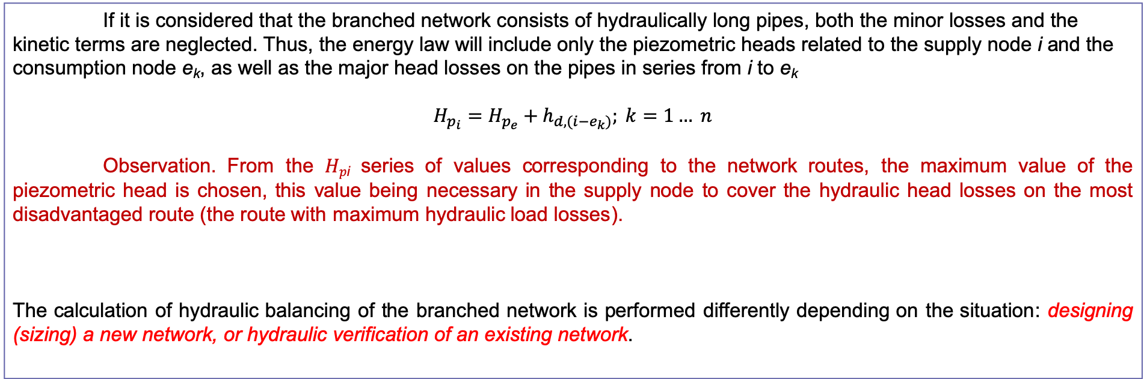
Athens UPB 012 - Water quality monitoring and control in distribution networks
Branched WDN sizing (3)
If it is considered that the branched network consists of hydraulically long pipes, both the minor losses and the kinetic terms are neglected. Thus, the energy law will include only the piezometric heads related to the supply node i and the consumption node e_{k}, as well as the major head losses on the pipes in series from i to e_{k}
$$H_{p_{i}}=H_{p_{e}}+h_{d,(i−e_{k})}; k=1… n$$
Observation. From the 𝐻_{𝑝i} series of values corresponding to the network routes, the maximum value of the piezometric head is chosen, this value being necessary in the supply node to cover the hydraulic head losses on the most disadvantaged route (the route with maximum hydraulic load losses).
The calculation of hydraulic balancing of the branched network is performed differently depending on the situation: designing (sizing) a new network, or hydraulic verification of an existing network.

Slide 17
Athens UPB 012 - Water quality monitoring and control in distribution networks
Sizing of a new branched WDN (1)
When sizing/designing a new branched network, the following data are known :
piezometric heads required in consumption nodes (junctions);
the flow rates in consumption nodes (junctions);
elevation at the reservoir.
Unknown data are:
pipe diameters;
friction factor coefficients corresponding to these pipes.
The problem can be solved by using the economic criterion of sizing the pipes, starting from considerations related to minimizing the investment and operating costs of the branched network considered.
Working steps:
Attempts are being made to reduce hydraulic head losses on the most disadvantaged route, by increasing the diameter of the pipes as much as the limits of economic velocities allow.
The aim is to increase the head losses on the other routes, so as to reach unique piezometric head in the nodes. The increase of hydraulic pressure losses is carried out in a first stage by reducing the pipe diameters within the limits allowed by the economic velocities, then, in the second stage, by introducing additional local hydraulic pressure losses (for example, on these end sections can be placed diaphragms, or partially closed valves)

Slide 18
Athens UPB 012 - Water quality monitoring and control in distribution networks
Hydraulic verification of an existing branched network
In this case, changing the pipe’s diameters is not possible, and hydraulic balancing is limited to the introduction of additional local head losses (generally on end sections for consumers other than the most disadvantaged consumer).
In the case of balancing branched networks, the piezometric head can be considered unique, if the values obtained for this for the different possible routes vary by less than 5% of the minimum value obtained in that node.

Slide 19
Athens UPB 012 - Water quality monitoring and control in distribution networks
Sizing of circular / looped WDN
From a hydraulic point of view, the circular WDN are networks in which the direction of the flow rates on the pipes is not known. Thus, the law of energy cannot be written in the usual way for solving the system of equations (it is not known which of the two nodes of the pipe is the input node and which is the output node). For this reason, the calculation of circular / looped WDN is performed iteratively.
To simplify the calculation, it is considered that the circular network consists of long pipes from a hydraulic point of view, in which case both the minor head losses and the kinetic terms are neglected.

Slide 20
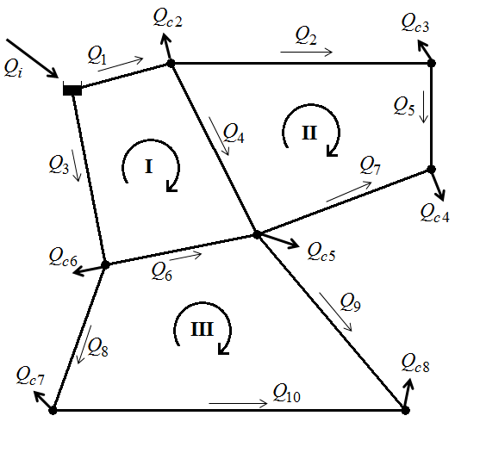
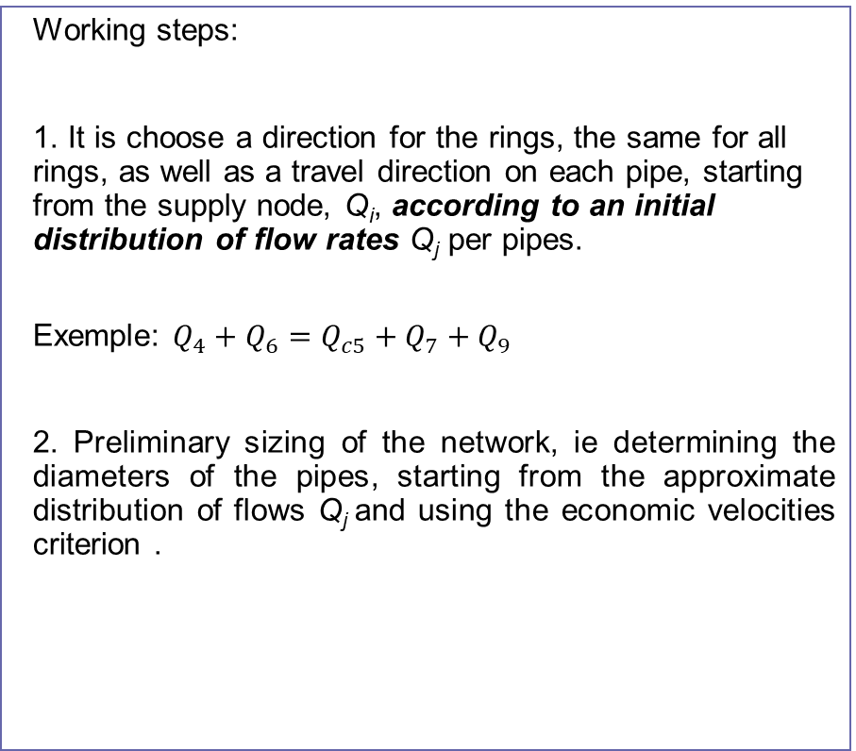
Athens UPB 012 - Water quality monitoring and control in distribution networks
Sizing of a new circular WDN (1)
Working steps:
1. It is choose a direction for the rings, the same for all rings, as well as a travel direction on each pipe, starting from the supply node, Q_{i}, according to an initial distribution of flow rates Q_{j} per pipes.
Exemple: $Q_{4}+Q_{6}=Q_{c5}+Q_{7}+Q_{9}$
2. Preliminary sizing of the network, ie determining the diameters of the pipes, starting from the approximate distribution of flows Q_{j} and using the economic velocities criterion .

Slide 21
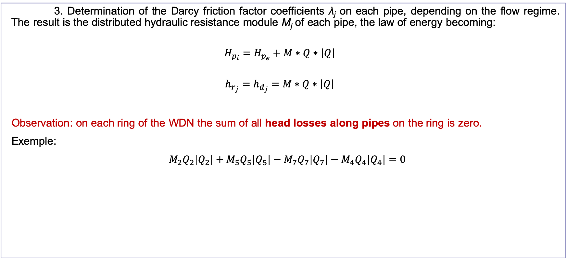
Athens UPB 012 - Water quality monitoring and control in distribution networks
Sizing of a new circular WDN (2)
3. Determination of the Darcy friction factor coefficients λ_{j} on each pipe, depending on the flow regime. The result is the distributed hydraulic resistance module M_{j} of each pipe, the law of energy becoming:
$$H_{p_{i}}=H_{p_{e}}+M∗Q∗\left|Q\right|$$
$$h_{r_{j}}=h_{d_{j}}=M∗Q∗\left|Q\right|$$
Observation: on each ring of the WDN the sum of all head losses along pipes on the ring is zero.
Exemple:
$M_{2}Q_{2}\left|Q_{2}\right|+M_{5}Q_{5}\left|Q_{5}\right|−M_{7}Q_{7}\left|Q_{7}\right|−M_{4}Q_{4}\left|Q_{4}\right|=0$

Slide 22
Athens UPB 012 - Water quality monitoring and control in distribution networks
Sizing of a new circular WDN (3)
4. Equations system for determining the unknowns. This system is made according to the chosen hydraulic calculation method:
flow-based hydraulic calculation methods, Q method – demand-driven hydraulic analysis (Hardy-Cross);
pressure based hydraulic calculation methods – pressure-driven or head-driven hydraulic analysis ;
hybrid hydraulic calculation methods.
The most commonly used method is the flow-based method, the Q method.
5. After determining the flow distribution on the network pipes, the hydraulic calculation is resumed from step 2. The calculation will be completed when for the chosen diameter and the flow obtained on each pipe, the velocity falls within the limits of economic velocities.

Slide 23
Athens UPB 012 - Water quality monitoring and control in distribution networks
Hydraulic verification of an existing circular WDN
In this case changing the pipe’s diameters is not possible and the calculation procedure contains only 3 steps from the previously mentioned ones: steps 1, 3 and 4.
For method Q, which is based on solving the system of nonlinear equations, the solution is obtained directly at the end of step 4. This convergence is ensured by the numerical method used to solve the system. It is recommended to use the Newton-Raphson method, a globally convergent method, which ensures that the final solution (network flow distribution) is obtained, regardless of the initial (starting) solution chosen in step 1.

Slide 24
Athens UPB 012 - Water quality monitoring and control in distribution networks
REFERENCES
Trifunović, N. (2020). Introduction to Urban Water Distribution: Theory (2nd ed.). CRC Press. https://doi.org/10.1201/9781003049852
S.C.Georgescu, A.M.Georgescu (2014). Manual de Epanet. Printech Ed., Bucharest, Romania

